Slide 1


Capital District
Motherhood Free Resource Fair
Hosted by Greenbush La Leche League
Facilitated by Lauren Keeley (Mom Tribe)
Notes:
Hello! I want to start off by thanking our wonderful host, Greenbush La Leche League for letting me put this event on. Thank you for all of our presenters as well as those that couldn’t be here today but gave permission to be presented so you all can get a whole host of resources in your back pocket. And thank you to all of YOU for attending today’s Resource Fair. We’ll be talking about a variety of supports for mothers and new parents in the Capital Region of Upstate New York. While I know this event is called the Motherhood Free Resources Fair, there will be several groups that support Dads, non-birthing partners and other supports like grandparents as well so know that we are inclusive of all parent-figures, but will likely be referring to Moms in particular for this presentation. We hope you go home with many new things that speak to you and please support these groups by liking them on facebook or Instagram, inviting your friends, or donating if you’re so able. Most of these groups are run by volunteers and depend on donations to keep going and I would be so sad to see any of them close their doors because we as Moms and parents deserve all the help we can get in raising these beautiful little ones who will be our next generation.

Slide 2
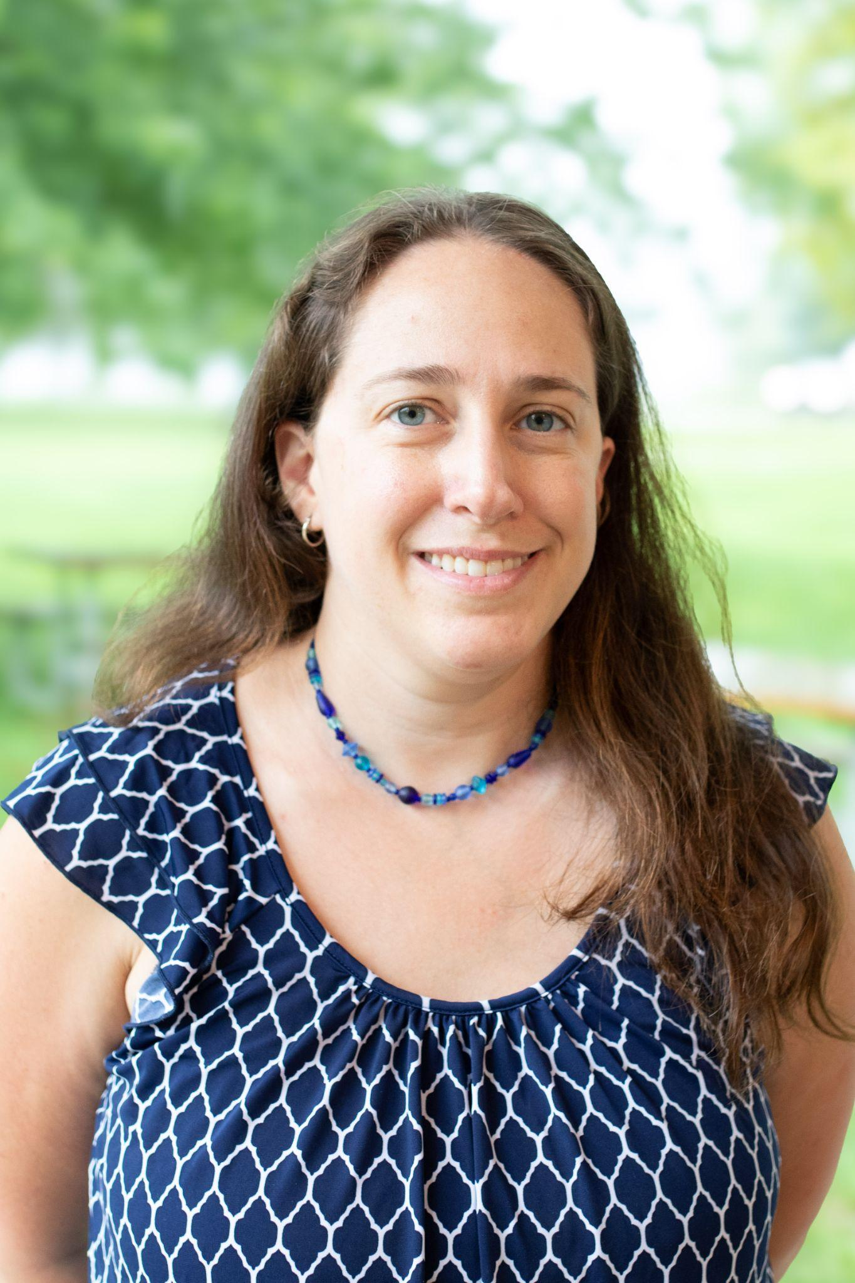
About Me
Live in Brunswick NY (Troy)
Husband and 19-month son
Licensed social worker
Works full-time from home for Fidelis
Extroverted, active, and always looking to support and be supported in life
Lauren Keeley
Notes:
First, a little bit about me. My name is Lauren Keeley. I live in Brunswick New York which is in Rensselaer County or Troy for those familiar. I have a husband named Walter and my 19-month old son named Joey. I’m a licensed clinical social worker or LCSW by trade and I currently work full-time from home for FidelisCare health insurance. I have previously been a child and adolescent therapist and worked closely with parents as well and prior to that I did home visits for parents of toddlers. I’m a self-declared extrovert who loves meeting new people, staying active, and love supporting Moms on their journey in parenthood.

Slide 3

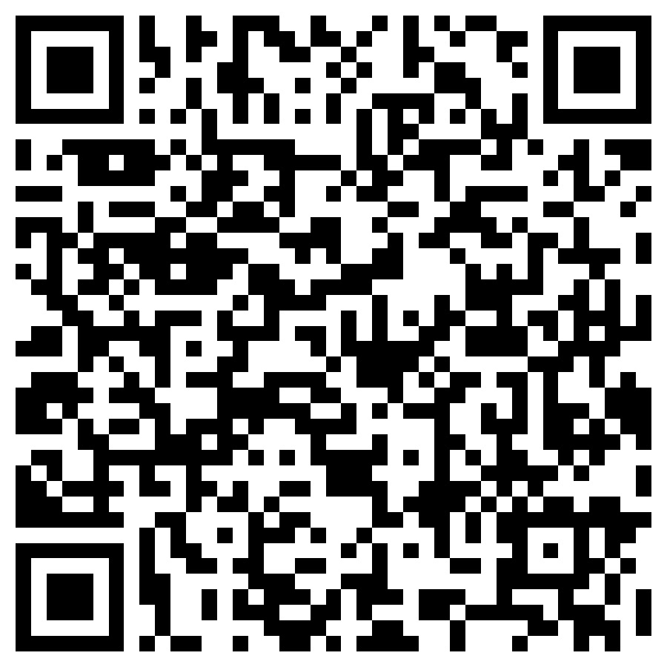
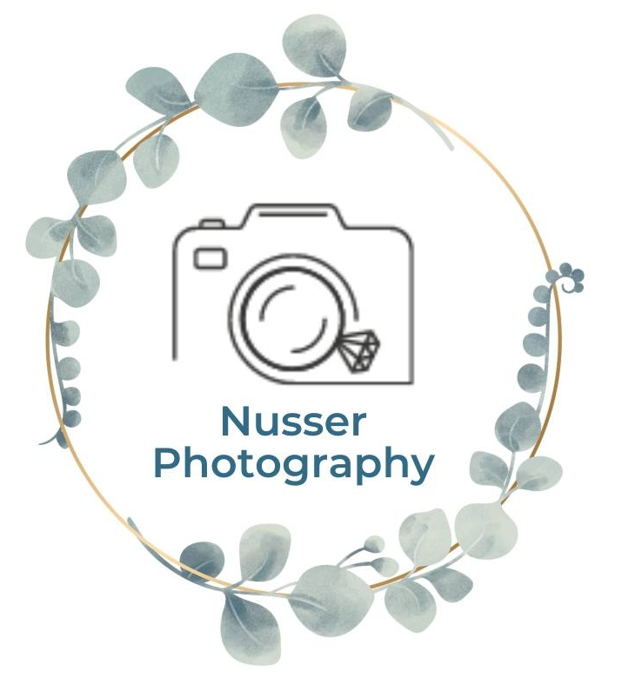
Recording & Raffle
This presentation is being recorded and the slides will be emailed out afterwards as well as uploaded to Greenbush La Leche League’s Facebook page.
Please fill out our attendance survey to receive the emailed resources and (Optional) to apply to receive a free photo session with Nusser Photography.
Notes:
https://forms.gle/XVgbBAK7W6uMVTre8
First a little housekeeping. As you may have seen when you log in, this meeting is being recorded so it can be shared far and wide afterwards. Most Greenbush La Leche League meetings are not recorded for confidentiality reasons but this one is a little different in nature. We do have an attendance survey I’ll put in the chat so you can sign-in and we can send this presentation and video to you afterwards. We also have received a wonderful raffle price for a free photo session with Nusser Photography. Thank you Erika, so if you’d like to win, please sign-in and mark that Yes to being here today and then Yes on page 2 to enter the raffle. If you have any questions feel free to put them in the chat as we go and there should be time at the end to ask our presenters your questions directly if you stick around until the end.

Slide 4
Lactation/Breastfeeding
Notes:
I’m going to start off with our host, Greenbush La Leche League to talk about their Lactation/Breastfeeding support groups.

Slide 5

Greenbush La Leche League -Cara Rosato Banks
La Leche League is a non-profit organization and the Leaders are all volunteers.
All lactating and expecting parents and their children are always welcome.
We encourage, inform, educate, support, and promote the use of human milk and the intimate relationship and development that comes from nursing a child for as long as mutually desired.
We hold support group meetings, offer one-on-one help via call, text or email, have a lending library of books and resources and more.
All La Leche League meetings follow a ‘come when you can, leave when you must’ policy. Also it’s like a buffet, take what advice you want a leave what you don’t.
Current Schedule:
The second Tuesday of the month from 10 – 11:30 am
The third Thursday of the month from 6:30 – 8 pm
The last Saturday of odd months from 10 – 11:30 am
Toddler Focused Meeting the First Monday of the month from 9:30-10:30
  All ages welcome
Follow us on: Website, Facebook, Instagram

Slide 6

Capital Region Baby Cafés -Chloe Blaise
Free Professional lactation support
Anyone is welcome! No insurance required.
Support persons and siblings are welcome as well.
Light refreshments available
Baby Cafe Meetings
  Troy Baby Café (Wednesdays 12pm-2pm)
  Albany Baby Café (Thursdays 11am-1pm)
  Schenectady Library Mont Pleasant Branch (1st and 3rd Mondays 11am-1pm)
  Schenectady Library Phyllis Bornt Branch (2nd and 4th Tuesday of each month
  Petersburg Public Library Café (1st and 3rd Tuesdays 12:30-2:30)
  Pop up Cafés at Stephentown Memorial Library and elsewhere
Additional Baby Cafe Meetings
  Virtual 1st Wednesday of the Month (6pm-7:30pm)
  Virtual 3rd Wednesday of the Month (6pm-7:30pm)
Website, Facebook, Instagram

Slide 7

Lactation Community Circle -Rebecca LaBombard
Chest/body/breastfeeding support group
First Friday of the month 12:00-2:00 in Ballston Lake
Third Thursday of the month 9:30-1130 in Delmar
Anyone feeding human milk to a baby including partners and caregivers are welcome as are non-school aged children
Come as you are. Stay or go as you need.
Website, Facebook

Slide 8
Babywearing

Slide 9
New York Babywearing -Rachael Southworth
Registered 501(c)(3) non-profit - Bringing babies and caregivers together through babywearing education and support.
4 in-person meetings statewide as well as a virtual meeting option, free try-ons and fit checks at every meeting.
Meets in Albany the last Sunday of the month 1-2:30, please see our Facebook for most up to date event information.
Become a sustaining member to get access to a wide variety of carriers to take home and try from our library.
Join our Facebook group for ongoing support.
Volunteers can receive free training to become babywearing educators.
Website, Facebook or email nybabywearing@gmail.com

Slide 10

Slingbabies -Heather Tremblay-Croteau
Free fit checks/fittings and education on Babywearing and child wearing.
Is an independent, nonprofit, all volunteer run organization that helps parents choose and safely use baby carriers and slings.
We do not sell slings or any type of baby carrier. Instead, we offer a lending library filled with a large variety of carriers/slings that people can check out and try.
We also offer many educational materials showing proper techniques that can be borrowed.
Website, Facebook

Slide 11
Birth support & Postpartum

Slide 12
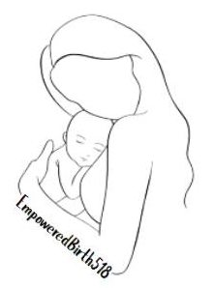
Empowered Birth 518 -Amy Funaro
We are a birth and parenting support group created for parents by parents.
Meets Monthly in Delmar, NY
  We cover a wide range of topics, from first-time parenting to welcoming second or third children, VBAC (Vaginal Birth After Cesarean), positive birth stories, the role of partners in parenting, and postpartum life.
  We believe in the power of positivity and understand that our diverse experiences unite and inspire us.
  We offer a comfortable, encouraging space for parents to find empowerment, advice, and resources.
  We are an inclusive community committed to uplifting and supporting each other.
  We are here to celebrate the strength within each of YOU!
Follow us on Facebook, Instagram, or email empoweredbirth518@gmail.com

Slide 13

Postpartum Support for Parents -Ariana Stadtlander
Based out of Delmar, NY
Designed to encourage and validate parents, and to build community with others who are on the same journey!
Meets in-person at Empowered Midwifery Care on the first Saturday of every month from 10:30am-12:00pm
Meets virtually over Google Meets on the third Monday of every month from 7:00-8:00pm
Free and open to all parents and partners of children ages 2 and younger. Registration is required.
Instagram or Email Ariana at embracingpostpartum@gmail.com

Slide 14

Moms to Help Moms -Kortney Conley
Connection to a fellow mom who will serve as your mentor—a trusted companion and supporter throughout this journey.
Whether you need guidance, a listening ear, or assistance in finding the right services, we're here for you every step of the way.
Website, Facebook, Instagram

Slide 15

The Body Workshop PT -Molly Conway
We are a Women’s Health physical therapy practice specializing in pregnancy and postpartum care.
  Pelvic floor PT for pregnancy and postpartum recovery
  Monthly Lactation Community circle -1st Friday of the month with The Milk Mentor
  Postpartum support Group- 3rd saturday of the month With mental health provider Hope IIron
  Birth preparation education classes with Tisha Graham
  We also offer tummy time classes and weekly running group
  Our goal is to connect birthing individuals in Community with the different resources that they are looking for.
Follow us on Facebook, Instagram, https://bodyworkshoppt.com/events/, or
email info@bodyworkshoppt.com

Slide 16

Birthright of Schenectady -Simone McGuinness*
Birthright is a pregnancy resource center that supports Moms and their families from pregnancy to the first birthday (up to size 2T and 6 diapers) of the child with material resources, as well as helping them locate what we cannot provide.
Birthright services are always free, confidential and available to any woman regardless of age, race, circumstances, religion, marital status or financial situation.
Open Mon-Friday 10am-1pm on Jay St. Schenectady
Check out our website and Facebook, 518-370-1532
Notes:
All volunteer, non-denominational pregnancy resource center. Self-administered pregnancy tests. Takes donations and helps with maternity clothing, take home from hospital bags for baby being born. They have a baby bundle of clothing and necessities and create relationships and safe place for Moms to come and chat and find resources. They don’t do furniture but have a large binder of resources and can help you find something if they don’t offer it. After baby is born they can support you until the baby is size 2T clothing and diapers up to size 6. Come in once a month for diapers/wipes and to talk to someone.

Slide 17

Project NICU -Amy Finn
Project NICU is dedicated to financially and emotionally supporting families with medically fragile infants in the Neonatal Intensive Care Unit (NICU) and the medical professionals who care for them.
We provide support through:
  Care Packages
  Virtual Support Groups, peer-support provided by veteran NICU parents, available to any NICU parent at any point in their journey.
  Free Mental Health Counseling through our partnership with BetterHelp
  Parent Mentorship Program
  Social Media Community - connecting families with other NICU families nationwide
Website, Facebook, Email

Slide 18
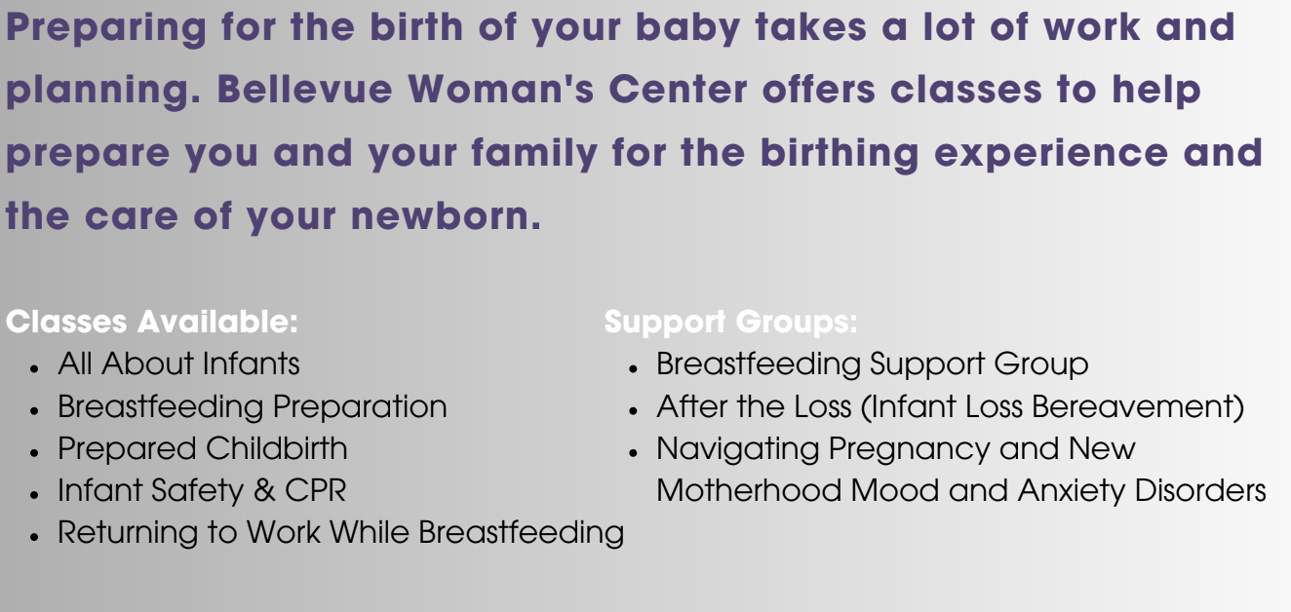

Bellevue Hospital -Kelsey Munn-Wilson
Prenatal education and postpartum support groups
Website

Slide 19
In-Person & Virtual
Playdates & Peer Support

Slide 20

Mom Tribe Meetups -Lauren Keeley
Monthly virtual support calls emailed out on Google Meet
Occasional in-person playdates at public or private locations
Free to all and caregivers/support individuals are welcome
Supportive environment to discuss struggles and successes
Feel free to come as you are, with or without your child(ren)
  Info & Guidelines available on Google Docs
To Join:
  Special Edition Meet & Greet on October 28th from 5:30-6:30pm
  Email LaurenBKeeley@gmail.com or message Lauren Keeley on Facebook

Slide 21

Mom Starts Here -Kyla Schmidt*
Variety of services to “to walk with families along their parenting journey. We provide support for the internal and external needs of parents so they can be at their best and have connected, loving relationships with their children.”
Peer groups & Ongoing Events. Recommended for Pregnancy Club members, but open to anyone
Baby items & Baby Showers
Parent hotline & Lactation support
Baby Furniture*
*Some items are income/Medicaid eligible
Website, Facebook, Email and App!
Notes:
Monthly support groups biweekly and once month. Lives in Events tab

Slide 22

Fern Coffee Walk & Talk -Heather Tremblay-Croteau
Parents/caregivers can come connect and get support while doing about 45 min of walking slow paced with their baby/child in stroller, carrier or other mode!
Then gather together at a coffee shop for more personal conversations and kiddo playing.
Some people come just to the coffee portion of they don’t feel up to walking.
Facebook

Slide 23
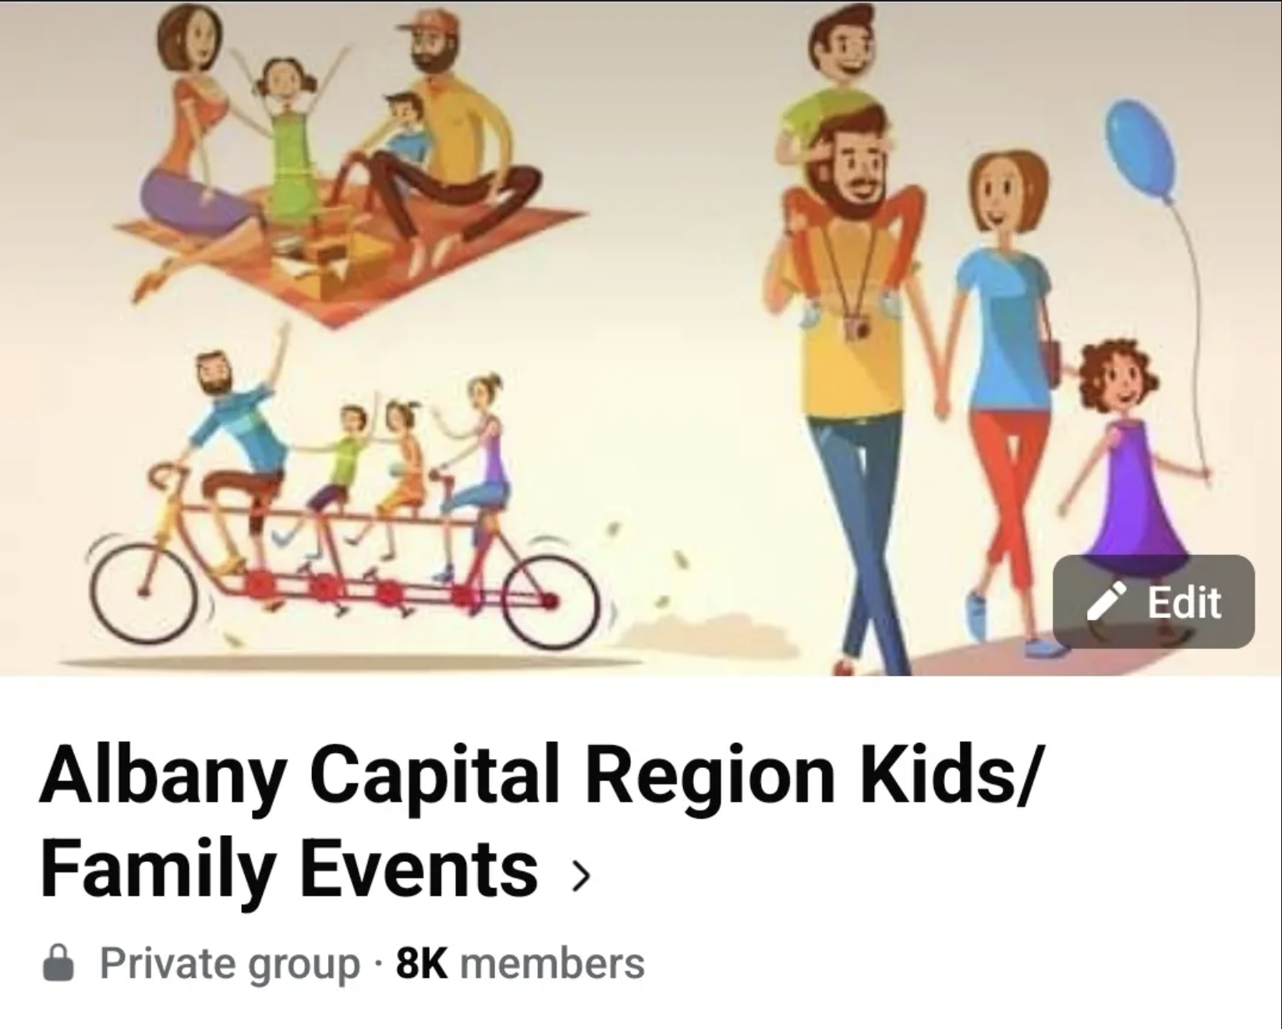
Albany Capital Region Kids/Family Events -Sweta Bhojak
Comprehensive group created in April 2022 that posts kids/family friendly events and activities across the Capital Region
Approx 50 mile radius of Albany Area and 8000+ members
Occasionally discount codes for paid activities
Any can attend these free and paid events
Diligently monitored to avoid scam posts
Facebook

Slide 24

MamaMayhem518 - Ashley
Digital Content. Follow along for the beautiful and chaotic journey of motherhood.
Purpose: to share tips, tricks, and inspiration for mamas looking to make memories with their littles. From products that make life easier to local happenings and everything in between, we’ve got you covered.
Finding all things family friendly in the 518: Parks, Events, Eats, Shops +more!
In-person meet-ups
Facebook, Instagram, Mamamayhem518@gmail.com

Slide 25

Sage Kinship Development -Shannon DuGuay*
Helping Families Thrive in the Capital Region
Evidence-Based Parenting Tips: Practical advice for nurturing emotional, social, and cognitive development.
Sensory Play & Learning Activities: Engaging, hands-on activities for children of all ages.
Parenting Insights & Support: Research-backed posts and videos on creating nurturing environments at home.
Facebook, Instagram or Email

Slide 26

Niskayuna Mom’s Group -Maeghan Gibbons*
We run a biweekly playgroup for Niskayuna mothers!
During the summer we meet every week at a local playground.
We welcome all Niskayuna moms to join us every other week for our playdate.
  Children usually age from 0-4.
To learn more, Facebook and look us up on Meetup

Slide 27

CultivatED Parenting -Sara Donnelly*
Hosts in-person and virtual playdates, virtual bible studies, virtual homeschool meetings and more
They continue to cultivate and develop support and resources for motherhood and homeschooling
You can sign up for the email list to get information on events through their website or by messaging/emailing
Website, Instagram, Email: cultivatedparenting@gmail.com

Slide 28
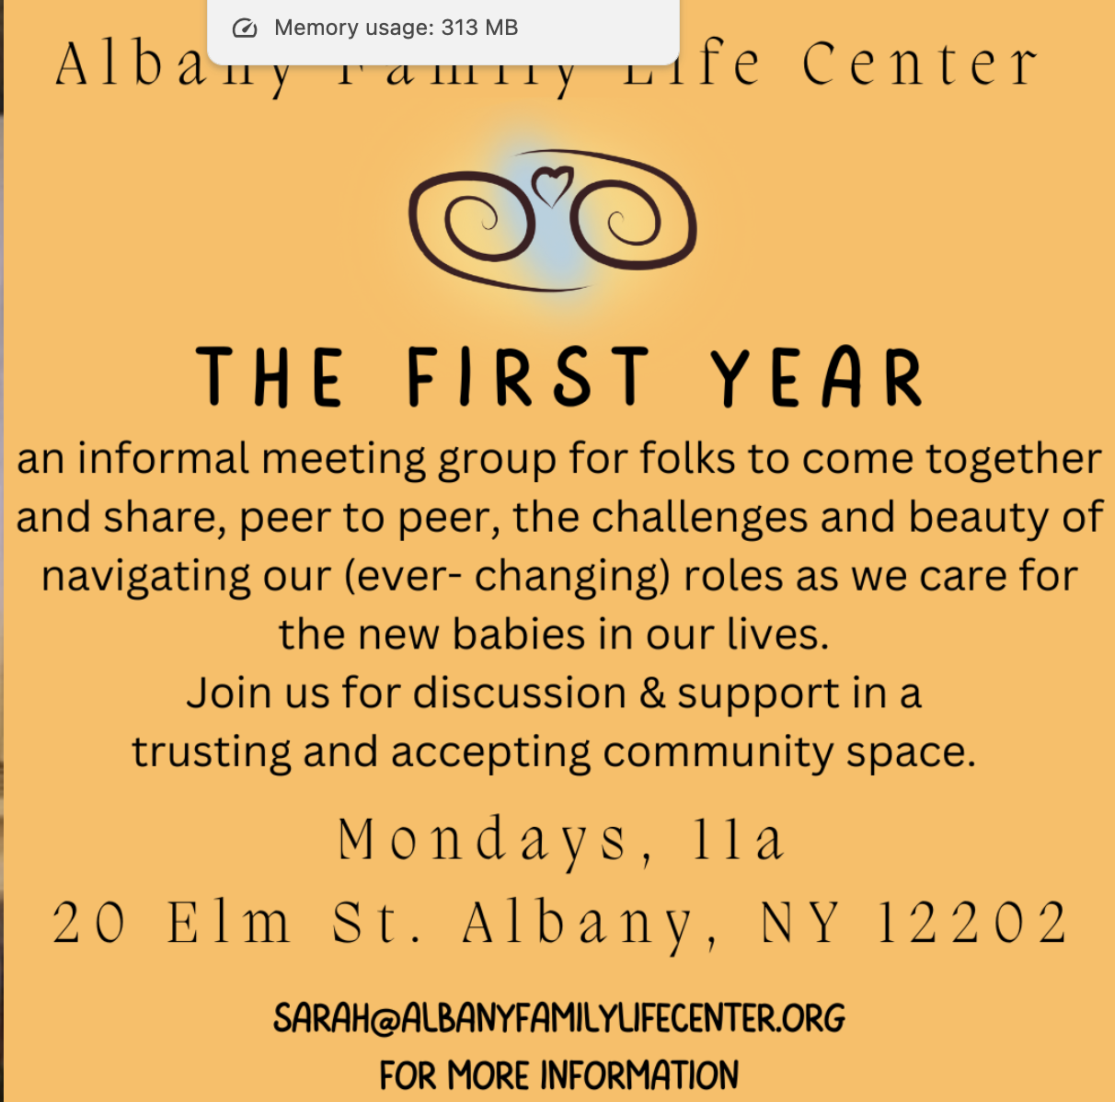
Website

Slide 29
Emergency Supports

Slide 30
Emergency Supports
Suicide Prevention Lifeline - Call/text 988
Domestic Violence:
  Domestic Violence Hotline - 1.800.799.SAFE (7233) or Text "START" to 88788
  Equinox of Albany
  Unity House (Troy)
  YWCA (Schenectady)
  Wellspring (Saratoga)
Food:
  Supplemental Nutrition Assistance Program (SNAP) - food stamps
  Women Infant & Children (WIC) - special supplemental nutrition while pregnant/infants
  Regional Food Bank - supplies food pantries around the region
Diapers/Wipes:
  Baby Item Network from Mom Starts Here
  Birthright Schenectady up to size 6 diapers
Other:
  Local Department of Social Services - Cash assistance & Medicaid
  New York State of Health (NYSOH) - apply for health insurance
  Social Security Benefits - for adult or children
  OCFS for Registered Childcare Facilities and Child-care assistance program
  Legal Aid Society - free/discounted legal consultation
  Lifeline - monthly telephone discount
FindHelp.com for many other resources

Slide 31
Other Free Resources

Slide 32
Library Story Times
Albany
  Albany Public Library - variety of days/times
  Cohoes Library - 1st Saturday at 11:00
Rensselaer
  Troy - Thursdays at 10:30, Friday at 10:00
  East Greenbush - T, W, Th at 10am, Some saturdays and evenings
  Brunswick - T, Th at 10:30
  Poestenkill - Friday 10:15
Schenectady
  Schenectady - M, T at 10:30
  Lactation consultation
Saratoga
  Saratoga Library - Variety of days/events
  Ballston Spa - Thurs at 10am
  Clifton Park - M at 10:30, Thurs at 10:00
And More!

Slide 33
Others Not Presented:
Pregnancy/Baby/Motherhood resources list by Lauren Keeley
Sesame Street - addresses tough topics like divorce and has free courses
Parents Helping Parents - support groups and Parent Stress Line 800-632-8188
Noteworthy Resources - Mental Wellness, Men’s Wellness, Grief, Casual Mom’s meetups (coming Jan 2025)
Healthy Schenectady Families
BirthNet
Additional Facebook groups:
Capital District Moms
518 Mom/Baby/Toddler/Kids Freebie Connect
Moms Time Out Capital Region
518 Breastfeeding
518 Parents
518 Stroller Club
518 Mom Book Club - monthly in person typically in Clifton Park

Slide 34
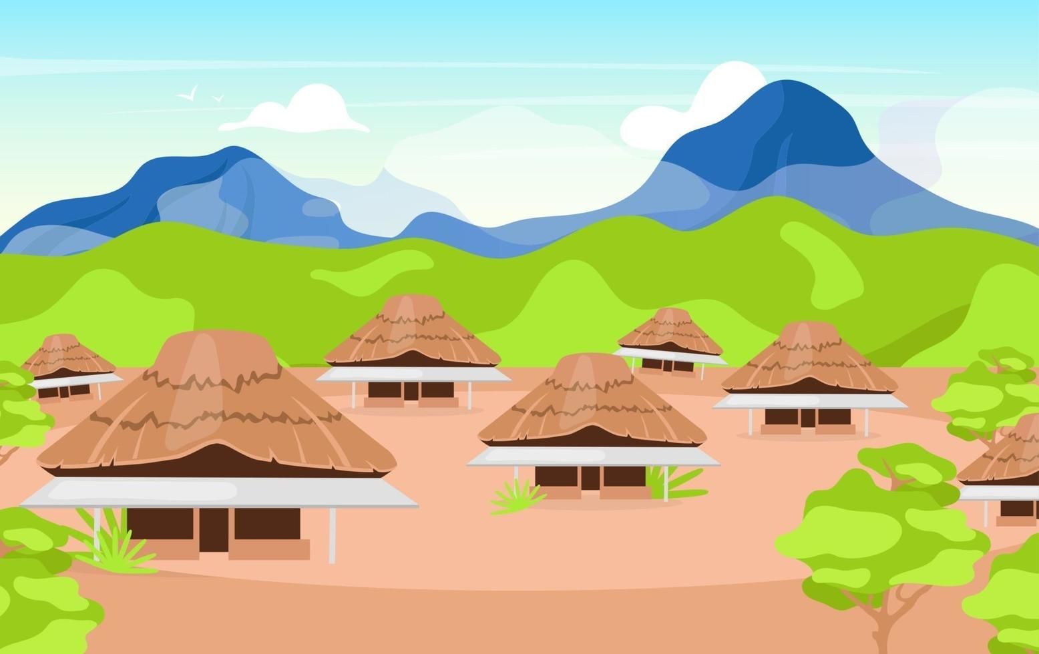
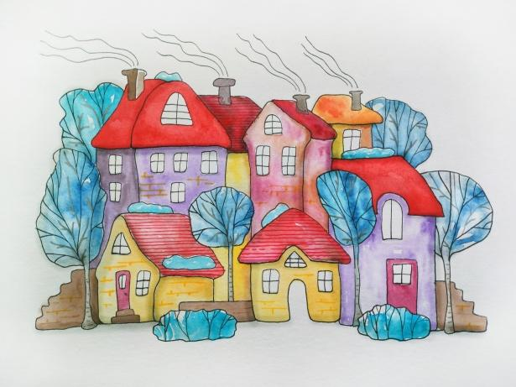
Find your village!
Thanks for attending
Notes:
https://forms.gle/XVgbBAK7W6uMVTre8

