Slide 1

Capital District
Motherhood Free Resource Fair
Round 2
Hosted by Becky LaBombard (The Milk Mentor)
Facilitated by Lauren Keeley (Mom Tribe)
Notes:
Hello and welcome to the Capital Districe Motherhood Free Resources Fair - Round 2! I want to start off by thanking our wonderful host, Becky LaBombard at The Milk Mentor for collaborating with me on this event. Thank you for all of our presenters as well as those that couldn’t be here today but gave permission to be presented so you all can get a whole host of resources in your back pocket. And thank you to all of YOU for attending today’s Resource Fair. We’ll be talking about a variety of supports for mothers and new parents in the Capital Region of Upstate New York. While I know this event is called the Motherhood Free Resources Fair, there will be several groups that support Dads, non-birthing partners and other supports like grandparents as well so know that we are inclusive of all parent-figures, but will likely be referring to Moms in particular for this presentation. We hope you go home with many new things that speak to you and please support these groups by liking them on facebook or Instagram, inviting your friends, or donating if you’re so able. Most of these groups are run by volunteers and depend on donations to keep going and I would be so sad to see any of them close their doors because we as Moms and parents deserve all the help we can get in raising these beautiful little ones who will be our next generation.
We have a lot to cover today with 38 presenting resources (some being presented by me so I hope you won’t get sick of my voice) and over 60 slides in this presentation. So let’s go!

Slide 2
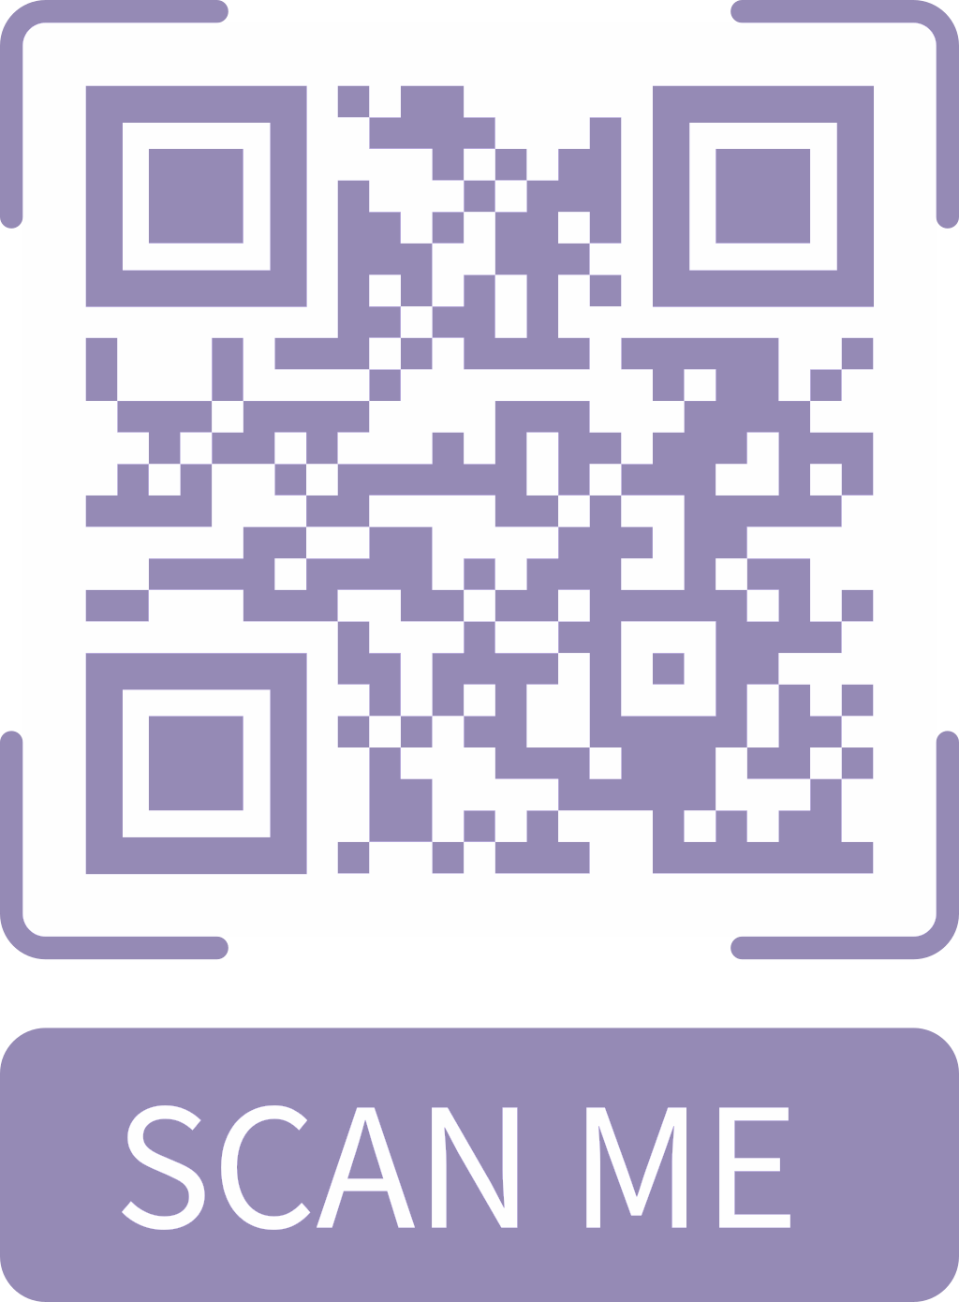
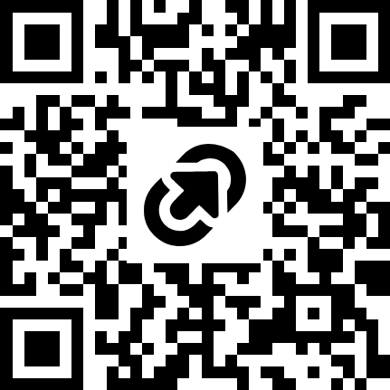
Recording & Raffle
This presentation is being recorded and the slides will be emailed out afterwards as well as uploaded to Greenbush La Leche League’s Website.
Please fill out our attendance survey to receive the emailed resources and (Optional) to apply to win a mini photo session with Nusser Photography.
Notes:
https://tinyurl.com/MomFair
First a little housekeeping. As you may have seen when you log in, this meeting is being recorded and transcribed so it can be shared far and wide afterwards. We ask that participants do not use AI recording devices since we already have ours on. We have an attendance survey in the QR code and I’ll put it in the chat so you can sign-in and we can send this presentation and video to you afterwards. We’re also offering a wonderful raffle prize for a free photo session with Nusser Photography to someone attending today. Thank you Erika, so if you’d like to win, please sign-in and mark that Yes to being here today and then Yes on page 2 to enter the raffle. If you have any questions, feel free to put them in the chat as we go and we’re hoping to have some un-recorded time at the end to ask our presenters your questions directly.

Slide 3
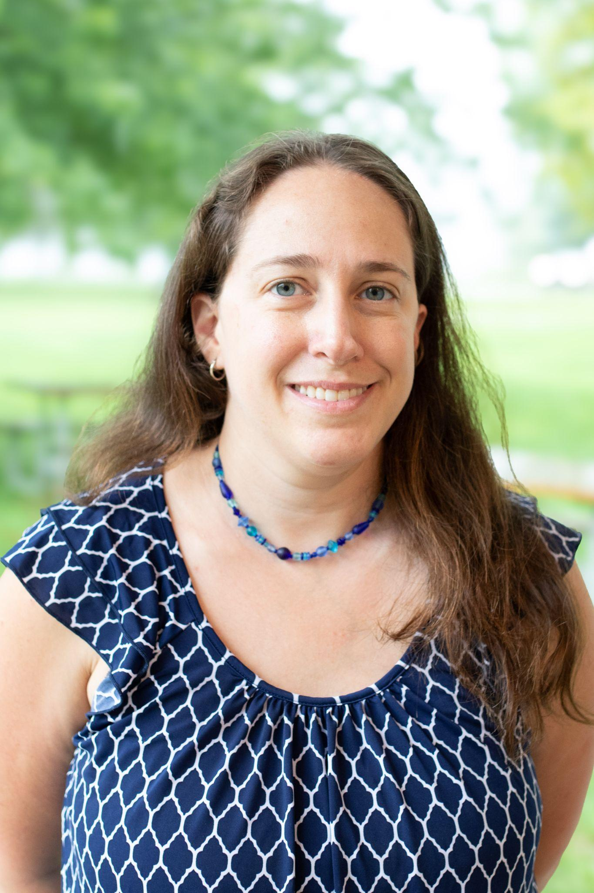
About Me
Lives in Brunswick NY (Troy)
Husband, 3-year old son and 3-month daughter
Licensed social worker
On maternity leave from full-time job
Extroverted, active, and always looking to support and be supported in life
Lauren Keeley
Notes:
Now for a little bit about me. My name is Lauren Keeley. I live in Brunswick New York which is in Rensselaer County about 15 mins east of Troy. I live with my husband Walter, my 3-year old son Joey and my baby girl Beth turned 3 months old today! I’m a licensed clinical social worker or LCSW by trade and I’m currently on maternity leave from my full-time job. Fun fact, most of this was created while nap trapped by my baby. I have previously been a child and adolescent therapist and worked closely with parents as well. Prior to that I did home visits for parents of toddlers. I’m a self-declared extrovert who loves meeting new people, staying active, and love supporting Moms on their journey in parenthood. I put together the first Free Resources Fair in Oct 2024 and noticed a lot has changed since then so I felt a round 2 was in order. I hope this will educate caregivers & professionals alike to the variety of resources in our community and help support Moms & Dads as they navigate the complexities of parenthood. No one was meant to do this alone so I hope if you’re listening to this that it’ll help you find your village of support.

Slide 4
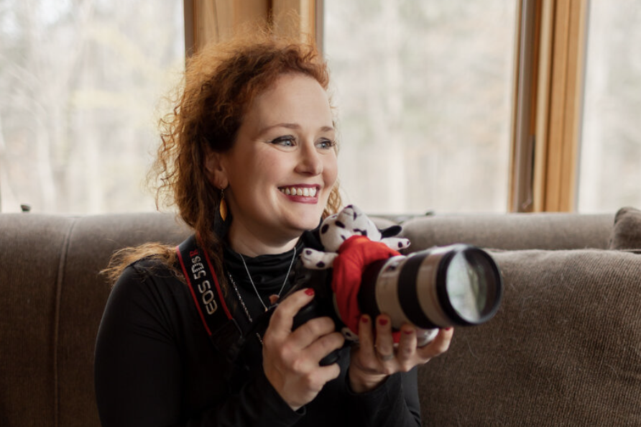

Thank You Nusser Photography!
Capturing love stories with joy, heart, and authenticity in Albany, NY & beyond
📸
Where real smiles, relaxed moments, and genuine connection shine. Welcome to Nusser Photography by Erika Reilly.

Slide 5
Lactation/Breastfeeding
Notes:
The first category of many today will be our Lactation/Breastfeeding supports.

Slide 6

Lactation Community Circle -Rebecca LaBombard
Chest/body/breastfeeding support group
First Friday's at The Body Workshop in Ballston Lake are 11-1
Second Tuesday of the month at Broadway Coffee Co. in Saratoga 10-12
Third Thursday at Lift and Breathe in Delmar 1-3.
Second Saturday 10-12 and Fourth Thursday 6:30-8:30PM at Chat Speech Albany.
Monthly at Play Hollow in Ballston Spa
Anyone feeding human milk to a baby including partners and caregivers are welcome as are non-school aged children
Come as you are. Stay or go as you need.
Website, Facebook, Instagram, Eventbrite
Notes:
I’m going to start off with our host, Becky LaBombard at the Milk Mentor to talk about her Lactation Community Circle.

Slide 7

Greenbush La Leche League -Shannon DuGuay
La Leche League is a non-profit organization and the Leaders are all volunteers.
All lactating and expecting parents and their children are always welcome.
We encourage, inform, educate, support, and promote the use of human milk and the intimate relationship and development that comes from nursing a child for as long as mutually desired.
We hold support group meetings, offer one-on-one help via call, text or email, have a lending library of books and resources and more.
All La Leche League meetings follow a ‘come when you can, leave when you must’ policy. Also it’s like a buffet, take what advice you want a leave what you don’t.
Check our pages for up-to-date meetings. Facebook Message groups are still active!
Website, Facebook, Instagram, Email
If you’re interested in becoming a Leader (running online or in-person events), marketing, or organizing our annual fundraiser Live Love Latch in August, please Email us.

Slide 8

Capital Region Baby Cafés
Baby Cafés are FREE resources for pregnant and breastfeeding families, offering;
  Support from specifically-trained staff
  Opportunities to share experiences and make friends
  Refreshments, comfortable seating, and open-forum discussions
Funded through a Breastfeeding, Chestfeeding, and Lactation Friendly New York (BFFNY) grant from the New York State Department of Health,
Support persons and siblings are welcome as well.
Baby Cafe Meetings
  Troy Baby Café (Wednesdays 12pm-2pm) at St. Mary’s Campus - 1300 Massachusetts Ave
  Albany Baby Café (Thursdays 11am-1pm) at Albany Housing Authority building - 200 South Pearl Street
  Schenectady Library Mont Pleasant Branch (1st and 3rd Mondays 11am-1pm)
  Schenectady Library Phyllis Bornt Branch (2nd and 4th Tuesday of each month)
  Pop up Cafés at Stephentown Memorial Library and elsewhere
  Various special events and virtual appointments if needed
Website, Facebook, Instagram, Email
Notes:
Baby Cafés are FREE resources for pregnant and breastfeeding families, offering;
• Support from specifically-trained staff
• Opportunities to share experiences and make friends
• Refreshments, comfortable seating, and open-forum discussions
Funded through a Breastfeeding, Chestfeeding, and Lactation Friendly New York (BFFNY) grant from the New York State Department of Health, St. Peter’s Health Partners Community Health Programs currently facilitates three Baby Cafes in the Capital Region and partners with Schenectady County Public Health Services run two in Schenectady County.
Baby Cafés are open in-person for all pregnant and lactating parents and their support people are welcome to attend! Pop in for support, encouragement, education and community.
Sessions are held in-person during the days and times listed on this slide
They also offer Virtual Support by appointment only
Available by appointment only. Email us at BabyCafe@sphp.com
Find us on Facebook: @capitalregionbabycafes
Find us at Instagram: @capitalregionbabycafes
https://linktr.ee/Capitalregionbabycafes?utm_source=linktree_profile_share&ltsid=e870f16e-ce63-4036-b029-a2f7a27963fc

Slide 9
Babywearing

Slide 10

New York Babywearing -Rachael Southworth
Bringing babies and caregivers together through babywearing education and support.
Free try-ons and fit checks at every meeting.
Meets in Albany the last Sunday of the month 1-2:30 pm @ Keystone PT
Become a sustaining member to get access to a wide variety of carriers to take home and try from our library.
Join our Facebook group for most up to date event information and for support in babywearing between meetings
Volunteer to become trained as a babywearing educator.
Website, Facebook or email nybabywearing@gmail.com

Slide 11

Slingbabies of the Capital District -Rebecca LaBombard
Free fit checks/fittings and education on Babywearing and child wearing.
Is an independent, nonprofit, all volunteer run organization that helps parents choose and safely use baby carriers and slings.
We do not sell slings or any type of baby carrier. Instead, we offer a lending library filled with a large variety of carriers/slings that people can check out and try.
We also offer many educational materials showing proper techniques that can be borrowed.
Website, Facebook, Instagram

Slide 12
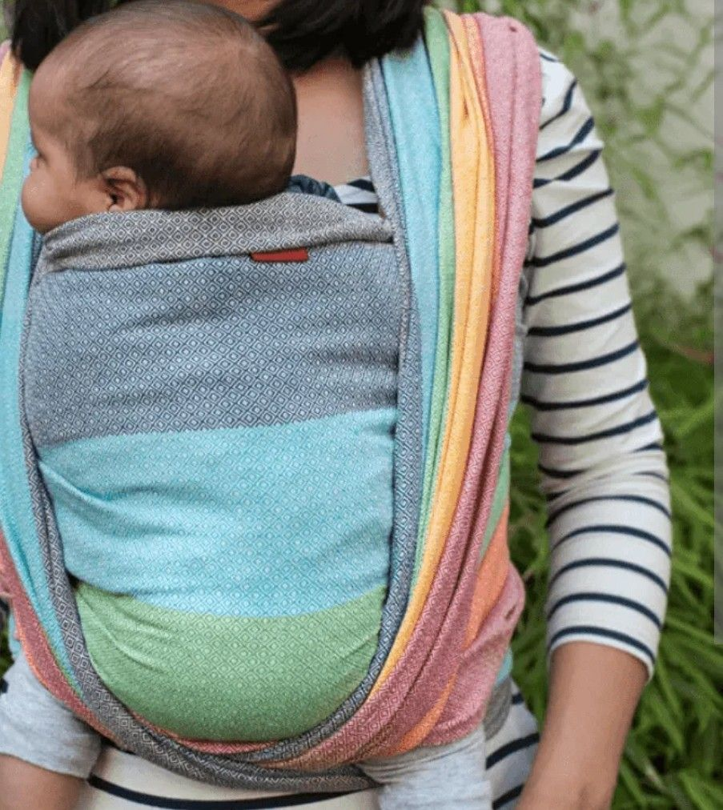
Woven Wrap Study Group -Kerrianne Durivage
Meet up to practice woven carrier wraps together
Anyone welcome: interested or experienced, planning or pregnant or not-so-new parents
Do not need to own a woven wrap to join or attend a meeting
See Facebook page for upcoming events/meetups
Facebook

Slide 13
Birth support & Postpartum

Slide 14

Embracing Postpartum -Ariana Stadtlander
A safe place for moms to be held and heard. We focus on building community, sharing resources, and supporting moms struggling with perinatal mood and anxiety disorders.
A free in-person support group located in Delmar, NY
Monthly group sessions held on the 1st Saturday of every month from 10:30am-12:00pm at Empowered Midwifery Care
Partners and babies are always welcome
Stay in touch throughout the month with our group chat through WhatsApp
Pre-registration is strongly encouraged
  Register here
Instagram or Email Ariana at embracingpostpartum@gmail.com

Slide 15

Mom Starts Here -Kyla Schmidt*
Variety of services to “to walk with families along their parenting journey. We provide support for the internal and external needs of parents so they can be at their best and have connected, loving relationships with their children.”
Peer groups & Ongoing Events. Recommended for Pregnancy Club members, but open to anyone
Baby items & Baby Showers
Parent hotline & Lactation support
Baby Furniture*
*Some items are income/Medicaid eligible
Website, Facebook, info@momstartshere.org
Notes:
Monthly support groups biweekly and once month. Lives in Events tab

Slide 16

Birthright of Schenectady - Karen Ronca
Birthright is a pregnancy resource center that supports Moms and their families from pregnancy to the first birthday (up to size 2T and 6 diapers) of the child with material resources, as well as helping them locate what we cannot provide.
Birthright services are always free, confidential and available to any woman regardless of age, race, circumstances, religion, marital status or financial situation.
Open Mon-Friday 10am-1pm on Jay St. Schenectady
See KLOVE Interview
Website, Facebook, 518-370-1532
Notes:
Birthright of Schenectady is an all volunteer, non-medical, apolitical, interdenominational self supported pregnancy resource center. Moms and their families are supported during the pregnancy to baby’s first year (size 6 diapers/size 2T clothing) with self-administered pregnancy tests, maternity clothing, material resources at monthly visits and volunteers to help navigate the journey. In addition to Moms, Dads, Grandparents, or other family members who find themselves supporting a baby can also come in for support. No appointment or referral is needed.
Birthright of Schenectady takes donations of gently used maternity clothing, baby clothing, books and small toys. We cannot take furniture our anything that a baby would sit in - stroller, baby carriers, etc. For more information please reach out to Simone at 518-370-1532.

Slide 17

The Body Workshop PT -Molly Conway*
We are a Women’s Health physical therapy practice specializing in pregnancy and postpartum care.
  Our goal is to connect birthing individuals in Community with the different resources that they are looking for
  Pelvic floor PT for pregnancy and postpartum recovery
  Monthly Lactation Community circle -1st Friday of the month with The Milk Mentor
  Postpartum support Group- 3rd saturday of the month With mental health provider Hope IIron
  Rebuild & Empower: Postpartum Strength & Movement exercise class with Britt Dietz Fitness.*
  Birth preparation education classes with Tisha Graham*
  We also offer tummy time classes and weekly running group
Facebook, Instagram, Website, or email info@bodyworkshoppt.com
Notes:
The Body WorkShop is a women’s health physical therapy practice dedicated to connecting women with local resources through every phase of life. Our postpartum support groups are facilitated by experts in their fields, creating a welcoming space for education, connection, and support.
• The Milk Mentor hosts a lactation Circle on the first Friday of every month from 11:00 AM–1:00 PM
• Hope Irion, LCAT, PMH-C, ATR-BC facilitates a Postpartum Mental Health Group on the third Saturday of every month from 9:00–10:30 AM, with discussion centered on all things postpartum
• We are also restarting our Free Running Group in May, which will meet on Wednesdays at 5:00 PM with our physical therapists

Slide 18

ICAN of the Capital Region -Melanie Nostrand
The International Cesarean Awareness Network is a non-profit organization whose mission is to improve maternal-child health by reducing preventable cesareans through education, supporting cesarean recovery, and advocating for vaginal birth after cesarean (VBAC).
We will have in person and virtual support meetings.
Follow us on Facebook, Website

Slide 19

Project NICU -Amy Finn*
Project NICU is dedicated to financially and emotionally supporting families with medically fragile infants in the Neonatal Intensive Care Unit (NICU) and the medical professionals who care for them.
We provide support through:
  Care Packages
  Virtual Support Groups, peer-support provided by veteran NICU parents, available to any NICU parent at any point in their journey.
  Free Mental Health Counseling through our partnership with BetterHelp
  Parent Mentorship Program
  Social Media Community - connecting families with other NICU families nationwide
Website, Facebook, Email: hello@projectnicu.com

Slide 20

Bellevue Hospital -Kelsey Munn-Wilson
Prenatal Education classes
All About Infants*
Breastfeeding Preparation*
Prepared Childbirth*
Returning to Work While Breastfeeding*
Introduction to Pumping & Exclusive Pumping Support Class*
Postpartum support groups:
Breastfeeding Support Group
NICU Support Group
Healing After the Baby Mental Health Support Group
After the Loss Bereavement Support Group
Lactation Support
Phone Triage: 518-346-9514
Outpatient Appointments covered by insurance
Website, Facebook, Instagram
*All classes and support groups are open to all (some covered/reimbursed by insurance), but our lactation services are priority given to woman delivering at BWC

Slide 21
NICU Support Group -Danielle Litz
This peer support session through Bellevue ensures you're not alone, provides insight and connection, and offers resources for clinical support if needed.
Virtual Sessions Available* - Tuesdays at 7pm via Zoom
  See Bellevue Website for specific dates
Partner Welcome
Baby Welcome
*Please note that this session is peer support only - it is NOT therapy or clinical mental health treatment.
Website

Slide 22

Healthy Families New York
A program to help parents with the changes and needs of their family that come along with the birth of a new child.
  Eligibility: Parents who are pregnant or have at least one child who is less than three months of age
  There is no cost to you. The program is a community service.
Offers services to expecting parents and new families, beginning weekly and decreasing over time, until the child starts school or Head Start.
Services are available in English and other languages, depending on the program serving each community.
Our assessment service helps you identify the successes and stressors that are unique to your family. After the assessment, you are provided personalized referrals that meet your family’s needs and goals.
Additional services may include: providing information about parenting, infant and child development, and child health; connecting you with medical providers for prenatal/well-baby visits and immunizations; assessing your child for developmental delays; and helping you to access community referral resources and services (such as job training, legal services, GED preparation classes, and more!).
Website
Find yours at: Albany, Schenectady, Rensselaer, Saratoga
Counties & more!

Slide 23

BirthNet
We are a birth justice organization whose mission is to eliminate the inequities in birth outcomes for all childbearing people and to ensure that all birthing families receive respectful and supportive maternity and infant care.
  Birth Justice Resources
  InfoHub to help find the information helpful in making informed decisions
  Community Events like Caregiver’s Night Out Bingo
  Doula Training
Website, Facebook, Instagram
Notes:
BirthNet is a community-rooted organization dedicated to advancing birth justice, supporting families, and uplifting doulas through advocacy, education, and collective care. We create consistent spaces for connection through our monthly doula meetups, where birthworkers gather to build community, share resources, and strengthen their practice. This spring, we are excited to host our first-ever Doula-Palooza on May 30—a full-day gathering focused on skill-building, wellness, networking, and celebration for doulas and birthworkers across our region. We are also planning a powerful Black Breastfeeding Week Celebration on August 29 to uplift Black families, normalize breastfeeding, and center joy, education, and community support.
In partnership with JBA, BirthNet is working to expand access to culturally responsive, community-based perinatal care by supporting and connecting doulas to families who need them most. Beyond direct support, we are committed to shifting systems and narratives: recently hosting a community film screening that sparked meaningful dialogue, as well as a birth justice forum that brought together providers, advocates, and families to address inequities and imagine solutions together.
As our work continues to grow, BirthNet is actively seeking dedicated community members to serve on our board as Treasurer and Secretary, individuals passionate about equity, sustainability, and community leadership. We are also looking to build relationships with funding partners and supporters who believe in reproductive justice and want to invest in the health and well-being of families in our community.

Slide 24

Back Home Midwifery -Heidi Back*
We provide a free 30 minute private individualized consultation to people who are interested in learning about homebirth and if it is an option for them.
Homegrown Monthly playgroup for people who have had homebirth midwives for their prenatal care or are considering home birth
See their website for FAQ's and Contact Us
Website, Facebook, Instagram

Slide 25
In-Person & Virtual
Playdates & Peer Support

Slide 26

Mom Tribe -Lauren Keeley
Monthly virtual support calls emailed out on Google Meet
Occasional in-person playdates at public or private locations
Free to all and caregivers/support individuals are welcome
Supportive environment to discuss struggles and successes
Feel free to come as you are, with or without your child(ren)
  Info & Guidelines available on Google Docs
To Join:
Email LaurenBKeeley@gmail.com
Or message Lauren Keeley on Facebook

Slide 27

Noteworthy Resources -Tatijana Benack
Support of individuals with mental health struggles—especially those in underserved and neurodivergent communities—by cultivating strong peer connections, promoting ADHD awareness, helping people access therapy and essential resources, and empowering them to self-advocate.
Peer Support Meet-ups:
  Casual Moms Meet-up, Men’s Mental Wellness Meet-up, Dark Moon Grief Gathering, Saratoga ADHD & Trauma Healing Meet-up, Empowered Neurodivergent Parent Meet-up, ADHD Awareness Coalition, Neurodivergence Parent Support Meet-up
Community Programs:
  FREE Confidential Therapist Search Service, Empowered Mothers Program, You Are Worthy program, Talk Saves Lives, Mental Wellness Coaching Service, ADHD Awareness Advocacy, Become a Certified Youth and Family Peer Advocate, The Awareness to Action Collaborative
Website, Facebook, Instagram, Phone: 518-250-9719

Slide 28

SHAC Community Center -Kerrianne Durivage
Not-for-Profit community center serving and helping children, families and seniors live a healthy, active life. We are passionate about healthy, active living. We develop trust, have fun, & create an emotionally & physically safe environment.
Various free programs:
  Baby & Me Music & Movement, Woven wrap study group, Family Game nights, Easter Egg hunt, Mindfulness Mornings, Story Writing, Aikido, Cooking, Mah Jongg, Alzheimer’s Caregiver support, Needlecrafts, Ping Pong, Dominoes, Art Studio, Craft club, Showshoe Walking, Bridge, etc…
Collaborations with Mom Starts Here, Baby cafes, East518 forest romps, Mother Henn book club, and always looking to expand offerings
Some other programs have cost and some are income eligible but most are for everyone and donations are appreciated
Facebook, Website

Slide 29

Niskayuna Moms Group - Gabrielle Bisaillon*
We run a biweekly playgroup for children 0-5 years old (siblings welcome)
During the summer we meet at local playgrounds
We create/maintain a safe environment for caregivers to connect and provide an area for children to socialize with other children
Our members are mothers from all over the Capital District
Facebook, Email: niskayunamomsgroup@gmail.com

Slide 30

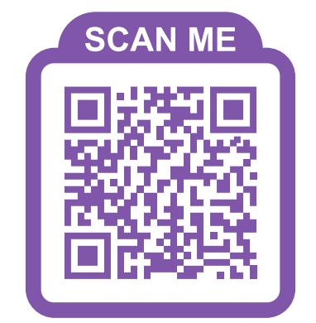
Mom’s Time Out - Celia Holmes
We are a casual group of moms that meets on the 1st & 3rd Saturday of the month at Delmar Reformed Church.
We welcome all moms and are not a religious group, but are sponsored by the church.
On the 1st Saturday of the month we have childcare available for $5 and meet with just us moms! We will sit and chat with coffee & treats or do a fun craft.
On the 3rd Saturday of the month, we have a play date with moms and kids! We usually plan crafts or play on the playground!
Stay up to date on our Facebook page or Instagram!
Facebook, Instagram

Slide 31

To Play and Wonder - Jen DeLancey
Bi-monthly playdates occur on Monday mornings at 10am at various locations
Opportunity for social connection for parents and children alike
If you are interested in attending a playdate, please Subscribe and RSVP by emailing or message on Instagram so we know you're coming!
Instagram, Email: toplayandwonder@gmail.com

Slide 32

New Parents Meetup
Meet, vent & connect with other new parents, guardians & caregivers in the community.
Twice a month, Saturday 10-1, Fridays 11-2
Come build your village – because it takes one!
While this meetup is geared towards new-ish parental figures, of all genders(!!), for kiddos under 4 years old, all caregivers are welcome to join in on the bonding!
No need to RSVP! Just show up with your little ones & an open heart!
Facebook, Website

Slide 33

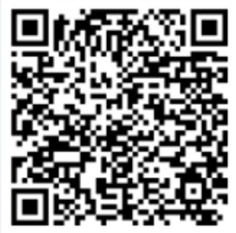
Mechanicville Area Community Service Center -Samantha Wagner*
Free parenting group twice a week, Tuesdays and Thursdays from 9:30-11am
  Childcare available for children ages 5 and under, and babies are welcome to stay with parent/caregiver
The Healthy Families Saratoga County Program
  A free and voluntary home visiting program for new and expectant parents/caregivers in Saratoga County
  Annual Community Baby Shower on 4/15 from 10-1, here at the center.
Other services offered: Food Pantry, Domestic Violence Services, Family Development (resources/advocacy/financial assistance), Teen/Youth programs, and we are a satellite center for ECS Psychological Services
Website, Facebook
Register for Baby shower here:

Slide 34

Motherhood Village Upstate - Mia Wirt*
Moms doing motherhood together
Offering support through our parenting journeys
Coffee dates, meetups & walks
East Greenbush & surrounding areas
Moms + babies of all ages
All are welcome
Facebook
Notes:
Looking for your people? Welcome to Motherhood Village Upstate. No more lonely nap-times or solo park trips. MVU is a grassroots support group serving the Upstate Capital Region. Our mission is simple: get moms and children out of the house and into a community of peers who truly get it. From playdates to group events, we provide the physical and emotional space for moms to lean on one another. Come find the support you deserve in the village you’ve been looking for.

Slide 35
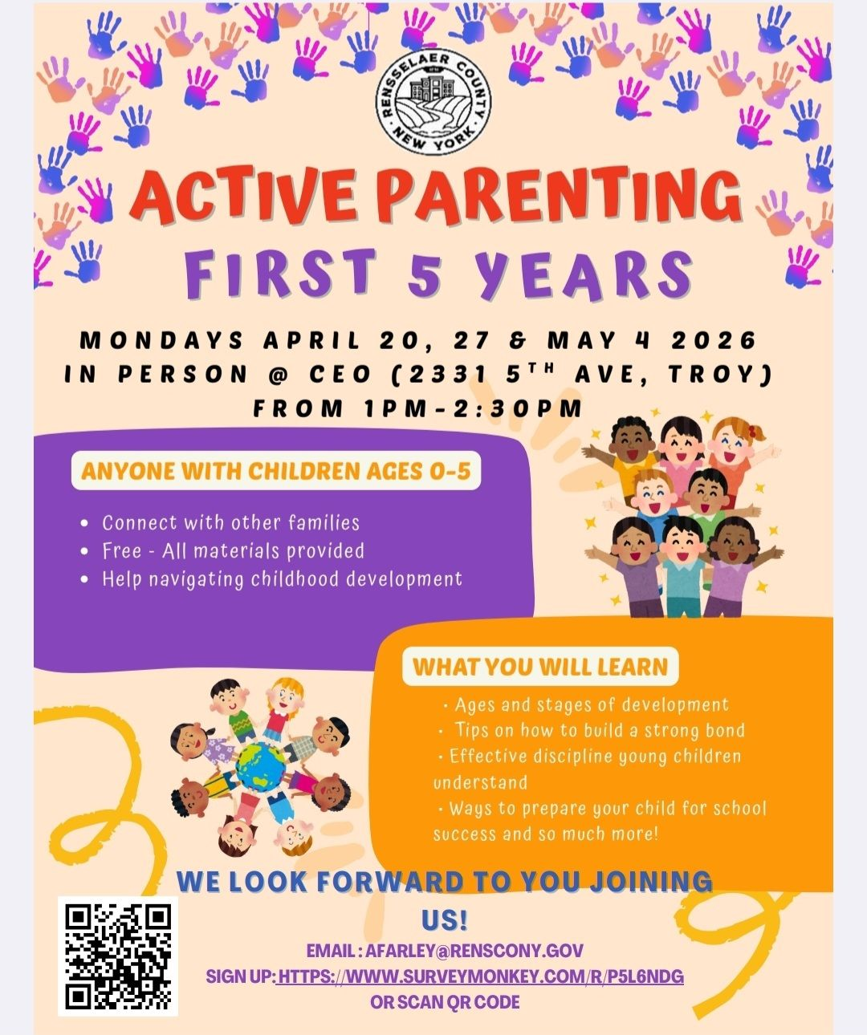
CEO Active Parenting Course
Also offers:
  Food Pantry (Thanksgiving & Holiday meals)
  WIC*
  Babies in Waiting - Home visiting
  Universal Pre-K, Early Head Start & Head Start*
  Foster Grandparent Program
  Weatherization*
  Volunteer Income Tax Assistance*
  Back to School Supplies & Coats
Website, Facebook
*Income eligibility

Slide 36
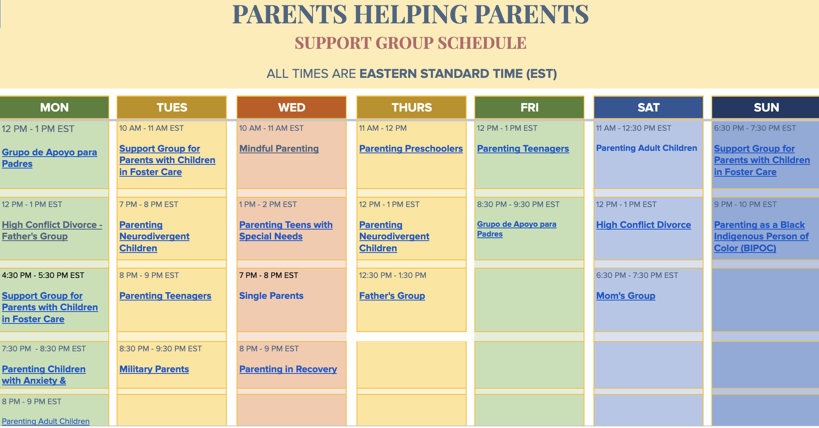
Parents Helping Parents - virtual support groups and Parent Stress Line 800-632-8188

Slide 37
Social Pages

Slide 38

MamaMayhem518 - Ashley
Digital Content. Follow along for the beautiful and chaotic journey of motherhood.
Purpose: to share tips, tricks, and inspiration for mamas looking to make memories with their littles. From products that make life easier to local happenings and everything in between, we’ve got you covered.
Finding all things family friendly in the 518: Parks, Events, Eats, Shops +more!
In-person meet-ups
Facebook, Instagram, Mamamayhem518@gmail.com

Slide 39

Sage Kinship Development -Shannon DuGuay
We help families in the Capital Region and beyond create loving, emotionally healthy homes where children and parents thrive. Our work is rooted in:
Gentle guidance and connection over perfection: practical support for real-life parenting challenges.
Emotionally informed parenting: helping children develop resilience, confidence, and secure attachment.
Developmentally grounded activities: hands-on learning, sensory play, and everyday strategies to support growth.
One-on-one support: free guidance for parents seeking personalized advice and resources.
Real talk, practical tools, compassionate support - for families who want to thrive, not just survive.
Facebook, Instagram, Substack, or Email

Slide 40

Moms to Help Moms -Kortney Conley
Social media podcast & posts talking about taboo topics in pregnancy, postpartum and parenthood
Interviews with other Moms about their experiences
Creates solidarity and shared sense of connectedness
Facebook, Instagram, TikTok, Youtube

Slide 41
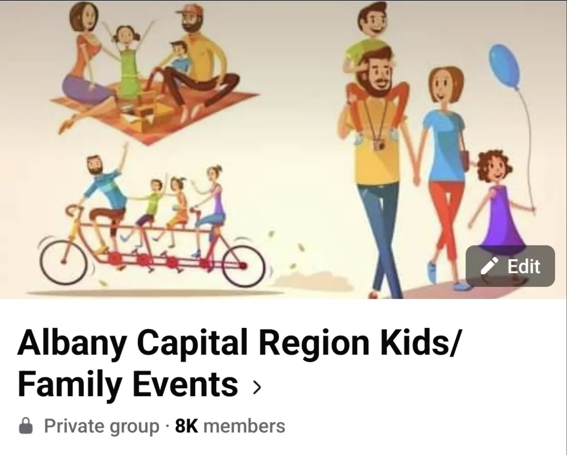
Albany Capital Region Kids/Family Events -Sweta Bhojak
Comprehensive group created in April 2022 that posts kids/family friendly events and activities across the Capital Region
Approx 50 mile radius of Albany Area and 9000+ members
Occasionally discount codes for paid activities
Any can attend these free and paid events
Diligently monitored to avoid scam posts
Facebook

Slide 42
Others Social Pages
518 Moms
518 Parents
518 Mom/Baby/Toddler/Kids Freebie Connect
518 Nannies, Babysitters, Daycares and Parents
518 Breastfeeding
518 Mama Tribe Adventures
518forFree
Moms Helping Moms 518
Capital District Moms has pages for Mom Groups, Playgrounds, Community Resources, Summer camps & More!
*Has a registration fee

Slide 43
Walks with Children

Slide 44

518 Stroller Club -Meaghan Knizek
Member-led stroller-friendly walks around local venues
Our goal is to provide regular meetups each week, however, day/time/locations depend on our volunteers.
We do our best to make sure our meetups serve as many members as possible
Meetups are strictly posted within the group & not to be shared to other pages as to keep our members safe as possible.
We welcome spouses/partners and siblings to join you
Join on Facebook, attend, and volunteer to host your own Stroller walk near you!
Facebook

Slide 45

Fern Coffee Walk & Talk -Heather Tremblay-Croteau
Free, community-based gathering for parents and caregivers
Led by Dr. Heather of Fern Physical Therapy, a sports and pelvic floor physical therapist
Offers a supportive space to move your body safely, ask questions, and connect with other parents and caregivers
Meets once a month from 12–2+ at Brewtus Roasting → optional walk on the Rail Trail (12–1) → coffee + connection (1–2+)
Designed to be low-pressure and flexible (walk, don’t walk, come late, leave early)
Babies, toddlers, and kids always welcome (bikes, scooters, strollers + carriers encouraged)
A space to feel less alone while building strength and community
No registration required—just show up
Dates are posted on social media
Website, Facebook, Instagram

Slide 46

East518 Forest Romps -Kerrianne Durivage
Regularly scheduled Forest meetups for moms, babies, toddlers, and others, east of the Hudson river!
A Walking Group where anyone is eligible
Weekend and weekday times, lots of outdoor walks, but some walks in museums and other indoor locations.
Facebook

Slide 47
Book Clubs

Slide 48

Mother Henn LLC -Haley Henn*
Caregiver Conversations Book Club (An education-based parenting support group. Parents are welcome to come for the company even if they don't read the book)
Open to all caregivers.
Focuses on one book each month that covers various topics relating to parenthood. While conversation is great when everyone has read the book, parents are welcome to come even if they haven't read the book (because parenting is busy!) if they just want to hear the highlights from others, or be with people interested in parenting topics.
Also offers postpartum doula and sleep consulting*
Facebook, Website, Email and the Book Clubs app
*for a reasonable fee
Notes:
Caregiver conversations is an education-based bookclub for anyone involved in the parenting, education, or enrichment of children. Monthly we read a book discussing a parenting philosophy, topic, ideal, or challenge and meet at SHAC in Averril Park on the final Thursday of the month for a group discussion centered around how, if at all, what we just read will impact our parenting. Caregivers who do not read the book, but are intersted in hearing about it are still welcome to come to bookclub for the footnotes, sense of community, or even just quick break from their children. Books previously covered include: The Anxious Generation, Vitamin N, Crib Sheet, and Bringing Up Bookmonsters.
Bookclub updates can be found through the Mother Henn Facebook page, or in the bookclubs app when you join our group "caregiver conversations." Books formerly discussed are added to our resource library. As a lover of books and a postpartum doula, book club is important to me because it allows caregivers a place to continue to learn and to grow their sense of community, both of which I consider to be crucially important to surviving postpartum and beyond.

Slide 49

518 Mom Book Club -Shannon DuGuay
In-person and online book club via Facebook, Fable, and StoryGraph
Members submit book recommendations quarterly
We vote every 3 months on the next 3 book selections
We meet monthly to discuss the book from the previous month (example: February meeting = January book)
Current in-person meetings are held at the Clifton Park Library
New members are always welcome!
Facebook
You are welcome to participate as much or as little as works for your season of life - no pressure, no guilt, just books and community.
Whether you are here for deep discussions, casual chats, reading challenges, or just book recommendations - you belong here💗
Notes:
📚How the Club Works
• Members submit book recommendations quarterly
• We vote every 3 months on the next 3 book selections
• We meet monthly to discuss the book from the previous month (example: February meeting = January book)
• Current in-person meetings are held at the Clifton Park Library
📍You are welcome to participate as much or as little as works for your season of life - no pressure, no guilt, just books and community.
📚 Books Already Read by 518 Mom Book Club
* Before We Were Strangers — Renée Carlino
* Black Cake — Charmaine Wilkerson
* Bury Our Bones in the Midnight Soil — V.E. Schwab
* Carrie Soto Is Back — Taylor Jenkins Reid
* Fourth Wing — Rebecca Yarros
* Funny Story — Emily Henry
* Great Big Beautiful Life — Emily Henry
* How to Sell a Haunted House — Grady Hendrix
* Just for the Summer — Abby Jimenez
* Lady Tan’s Circle of Women — Lisa See
* Lessons in Chemistry — Bonnie Garmus
* Local Woman Missing — Mary Kubica
* Mad Honey — Jennifer Finney Boylan and Jodi Picoult
* Malibu Rising — Taylor Jenkins Reid
* None of This Is True — Lisa Jewell
* Onyx Storm — Rebecca Yarros
* Project Hail Mary — Andy Weir
* Remarkably Bright Creatures — Shelby Van Pelt
* She Wouldn’t Change a Thing — Sarah Adlakha
* The Boyfriend — Freida McFadden
* The Dead Romantics — Ashley Poston
* The Frozen River — Ariel Lawhon
* The Husbands — Holly Gramazio
* The Invisible Life of Addie LaRue — V.E. Schwab
* The Island of Sea Women — Lisa See
* The Last Letters — Rebecca Yarros
* The Last Thing He Told Me — Laura Dave
* The Lilac People — Milo Todd
* The Lost Bookshop — Evie Woods
* The Midnight Library — Matt Haig
* The Nightingale — Kristin Hannah
* The Only One Left — Riley Sager
* The People We Keep — Allison Larkin
* The Seven Husbands of Evelyn Hugo — Taylor Jenkins Reid
* The Vanishing Half — Brit Bennett
* The Wedding People — Alison Espach
* The Women — Kristin Hannah
* Tomorrow, and Tomorrow, and Tomorrow — Gabrielle Zevin
* Where the Crawdads Sing — Delia Owens
🗓️ Upcoming Picks
• April: The Three Lives of Cate — Kate Fagan
• May: First-Time Caller — B.K. Borison
• June: Finlay Donovan is Killing It — Elle Cosimano
• July: Broken Country — Clare Leslie Hall
• August: The Correspondent — Virginia Evans
🗣️Help Shape the Club
Your feedback truly matters. We have an ongoing feedback form to help us make meetings and discussions more engaging and accessible for everyone:
👉 https://forms.gle/LbHmtFhPyA97x3Vr9
📚✨NEW: 518 Mom Book Club 2026 Reading Challenge!
We are bringing back a refreshed 24-category reading challenge for 2026 - designed to be flexible, fun, and zero pressure.
✔️ Read at your own pace
✔️ Pick 1–2 categories a month or jump around
✔️ Share progress freely in the group
✔️ Track on StoryGraph if you would like
Join here 👉 https://app.thestorygraph.com/.../c61233b3-ab0c-45b3-a80f...
📖 NEW: Online Book Discussions
Can’t make the in-person meeting or want to chat while reading?
Join us on Fable for spoiler-free, chapter-by-chapter discussions and final reflections:
👉 https://fable.co/.../518-mom-book-club-with-shey...
🏆 NEW & FUN: 2026 Book Bracket
Every two months, we will vote head-to-head:
• Jan vs Feb
• Mar vs Apr
• May vs Jun
➡️Best of the first half
Then:
• Jul vs Aug
• Sept vs Oct
• Nov vs Dec
➡️Best of the second half
➡️Final showdown for Book of the Year!
✨Whether you are here for deep discussions, casual chats, reading challenges, or just book recommendations - you belong here💗
Here is to a year of great books, meaningful conversations, and community that meets you exactly where you are📚

Slide 50

Grown Up Book Club* -Megan Miles
Meets monthly at Play Hollow in Ballston Spa, a storefront and play space with classes and other events
Next meeting is on Wednesday 4/15 at 7pm!
Come hang out and discuss whatever books you have been loving lately. We will recap The Women for anyone who participated in our featured read, but all book talk welcome. We will also pick our theme for the coming month.
Book swag, snacks, and drinks will be served!
20% off any in store shopping that night for all in attendance
Also hosts a Mom Night, Monthly Lactation Circle, and kids classes/events routinely
*Adults-only due to topics discussed
Website, Facebook, Instagram
Notes:
Adults only due to topics discussed
Play space is free on Tuesdays 10-12
Open Plan fee is waived if you make an in-store purchase

Slide 51
Dad Supports

Slide 52

Dad_Shift -Juan Cardona
Dad_shift is a group for dads, dads-to-be and veteran dads. It is a safe space for dads to share experiences and talk to each other about the changes that come with fatherhood.
Outings are once or twice a month and the only requirements are that :
  You are a dad
  You bring your little one!
We are just a bunch of dudes trying to survive the shift into fatherhood. So come and enjoy the company and wisdom of other dads and let’s build a dad-led support network!
Instagram

Slide 53

Community Fathers, Inc.
The Fathers Support Group Meets Wednesdays @ 6:30pm at 313 Clinton Street, Schenectady, NY 12305
  All are welcome - No registration necessary
On hold at this time:
  Occupations Instead of Incarceration (OIOI)
  Meals & Heal
  Community Justice Programs
  Domestic Violence for Batterers Group​
Website, Facebook
Notes:
The mission of Community Fathers has been to provide self help opportunities and supportive services to fathers, families, and communities.
The core of our efforts is to bring the communities ideas and passions to the range of activities we’re involved in. Through all of our endeavors we strive to display the conviction behind our vision, that we can create a world where all men realize their value as caretakers of their communities!

Slide 54
Emergency Supports

Slide 55
Emergency Supports Call 211
Suicide Prevention Lifeline - Call/text 988
The Living Room & The Family Room - Walk-In Mental Health Support for Adults & Youth Ages 5–17
Domestic Violence:
  Domestic Violence Hotline - 1.800.799.SAFE (7233) or Text "START" to 88788
  Equinox of Albany
  Unity House (Troy)
  YWCA (Schenectady)
  Wellspring (Saratoga)
Food:
  Supplemental Nutrition Assistance Program (SNAP) - food stamps
  Women Infant & Children (WIC) - special supplemental nutrition while pregnant/infants
  Regional Food Bank - supplies food pantries around the region
Diapers/Wipes:
  Baby Item Network from Mom Starts Here
  Birthright Schenectady up to size 6 diapers
Other:
  Local Department of Social Services - Cash assistance & Medicaid
  New York State of Health (NYSOH) - apply for health insurance
  Social Security Benefits - for adult or children
  OCFS for Registered Childcare Facilities and Child-care assistance program
  Legal Aid Society - free/discounted legal consultation
  Lifeline, Assurance Wireless, Safelink- free phone/discount for eligible individuals
FindHelp.com for many other resources

Slide 56
Other Resources

Slide 57
Special Needs
Early Intervention - contacts for each county in New York
START Children's Center - trauma-informed services
Center for Disability Services - services for disabilities
  AIM High Resource Center - parent-to-parent and professional services and support to individuals with Down syndrome and their families.
Catholic Charities Disability Services - independence for developmental disabilities
Parent to Parent - Support Services for Special Needs Caregivers in NY State
Ronald McDonald House - essential services for when children need healthcare.
Access-VR - employment and independent living assistance
Sesame Street - addresses tough topics like divorce, disability and has free courses
Northern Rivers Family Services - mental health, foster care and other supports
Medicaid Health Homes - caseworker to help navigate healthcare needs
Home and Community Based Services (HCBS) & Community Oriented Recovery & Empowerment (CORE)

Slide 58
Library Story Times/Play Groups
Albany
  Albany Public Library - variety of days/times
  Cohoes Library - 1st Saturday at 11:00
Rensselaer
  Troy - Th at 10:30, Playtime Pals - Monthly at YWCA
  East Greenbush - T, W, Th at 10am, Some Saturdays and evenings
  Brunswick - T, Th at 10:30
  Poestenkill - Friday 10:15
  Grafton State Park Toddler Time - Th 10am
Schenectady
  Schenectady - Most days of the week at different locations
  ECOS Central Park - W at 10 from Apr 1 to June 17
Saratoga
  Saratoga Library - Variety of days/events
  Ballston Spa - Th at 10am
  Clifton Park - M and Th at 10
And More!

Slide 59
Nature & Indoor Centers - often free programs
Albany
  Albany Pine Bush Preserve
  Five Rivers Environmental Education Center
  Emma Treadwell Thatcher Nature Center
  New York State Museum - Discovery Place
Rensselaer
  Burden Pond Preserve
  Dyken Pond Environmental Center
  Grafton Lakes State Park
  Hudson Taconic Lands
Schenectady
  Central Park - ECOS Connecting Tots to Nature
Saratoga
  Peebles Island State Park
  Saratoga Spa State Park

Slide 60
Others Resources
*Has registration fee(s)
Broadway Coffee Co - Fourth Trimester Series & Little Songbirds class*
Round Lake Doula - Fourth Trimester Circle*
Fit4Mom Upstate Saratoga - Group exercise classes, first one free*
Play, Create & Explore - Group dynamic activities for children/families*
Carrier Connection - Babywearing lending library*
Cornell Cooperative Extension - Positive Parenting Education
Parent & Children Programs - at Albany Medical Center
Family Focused Services - at Trinity Alliance
Stronger Families New York - Drop-in play groups, parenting workshops support groups, and family events
Dolly Parton Imagination Library - free books delivered to children 0-5yrs
County Resource Guide(s) - From The Food Pantries of the Capital District
Compendium of Services - OCFS List of resources
Albany Family Life Center Resource List*

Slide 61
Full Resource List
All of our resources are available in the following list for easy access:
Pregnancy/Baby/Motherhood resources list
by Lauren Keeley

Slide 62
Bonus: Play Spaces

Slide 63
Community Play Spaces - Not Free*
Barbara’s School of the Dance - Delmar
Billy Beez (Crossgates Mall Albany)
Bring on the Spectrum - Albany
Chuck-E-Cheese (Latham)
Daisy’s Kids Cafe (Queensbury)
Dragonfly and Owl (Wynantskill)
Get Air Trampoline Park (Albany)
Go Playland (Colonie)
Guptill’s Roller Skating Arena (Cohoes)
House of Flavia’s Playhouse (Rensselaer)
Kids Ultimate Playground (Albany)
Little’s Play Cafe (Latham, Delmar, Rotterdam, Clifton Park)
Magic Meadows (Clifton Park)
MiSci (Schenectady)
My Lighthouse (Castleton-on-Hudson)
Play Hollow - Ballston Spa
Sky Zone (Clifton Park, Queensbury)
Tiger Mama (Troy)
The Children’s Museum at Saratoga
Urban Air Adventure Park (Albany)
Wiggle Worms Playland (Saratoga)

Slide 64

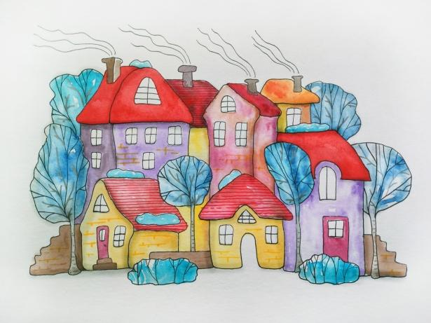
Find your village!
Thanks for attending
Notes:
https://tinyurl.com/MomFair

